Slide 1
PIERCING & TATTOO WEBSITE DESIGN
Athanasios Ktenas
ITC4214

Slide 2
RED ACCENTS ON LIGHT AND DARK MODE

Slide 3
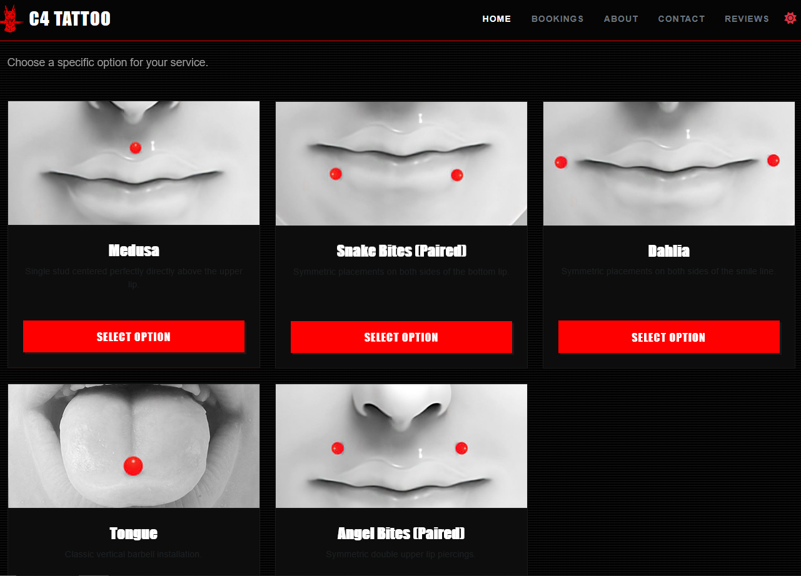
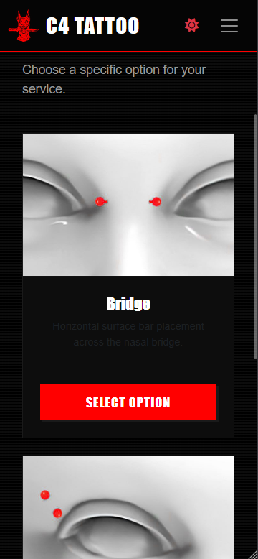

Slide 4
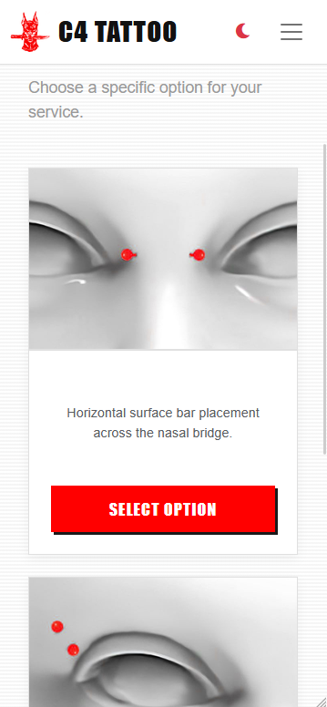
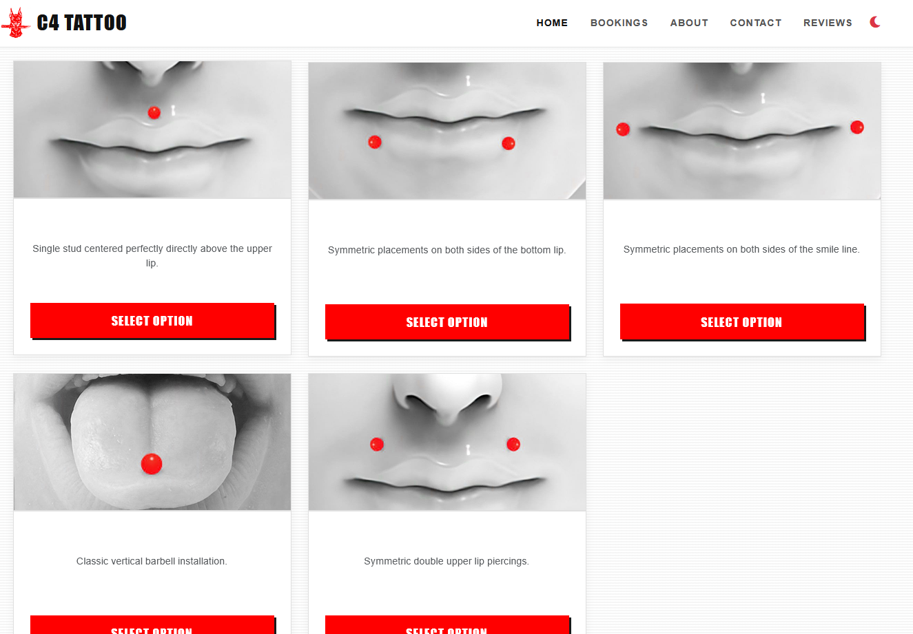

Slide 5
RESPONSIVE DESIGN

Slide 6
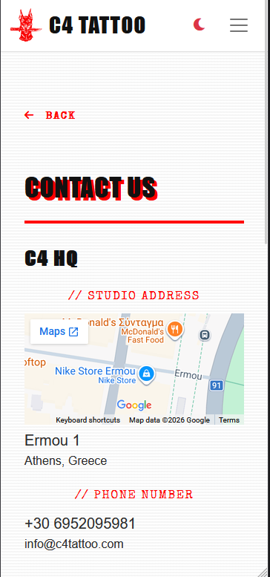
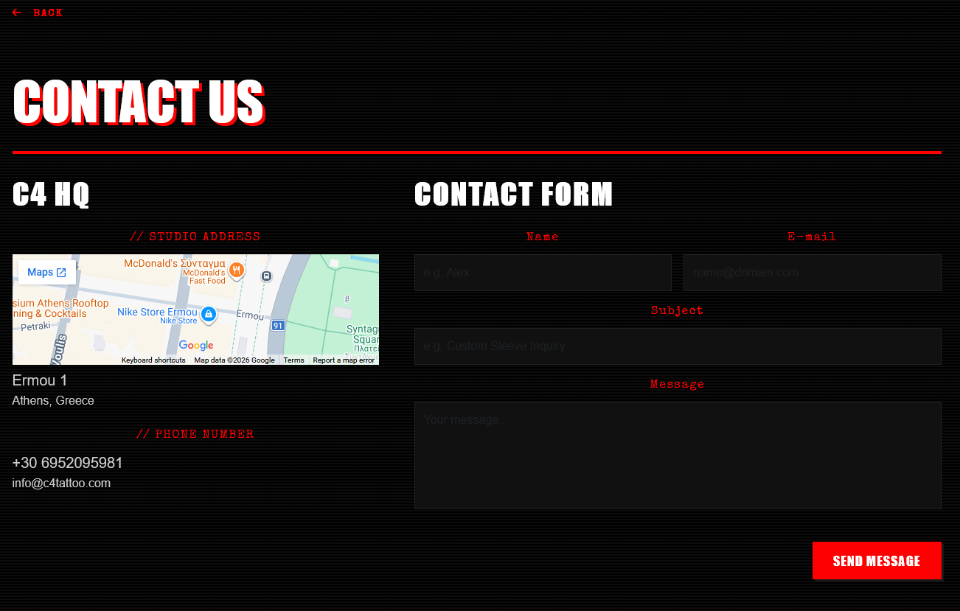

Slide 7
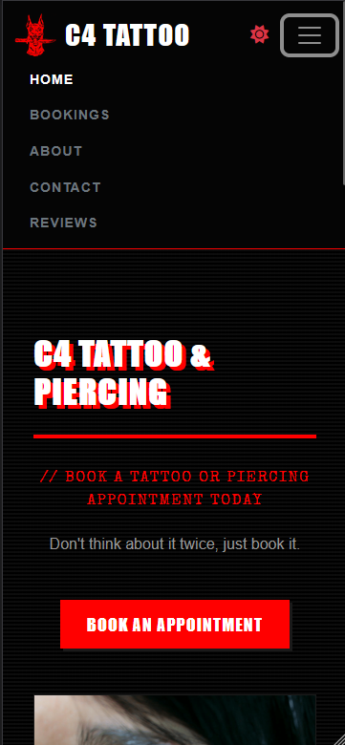
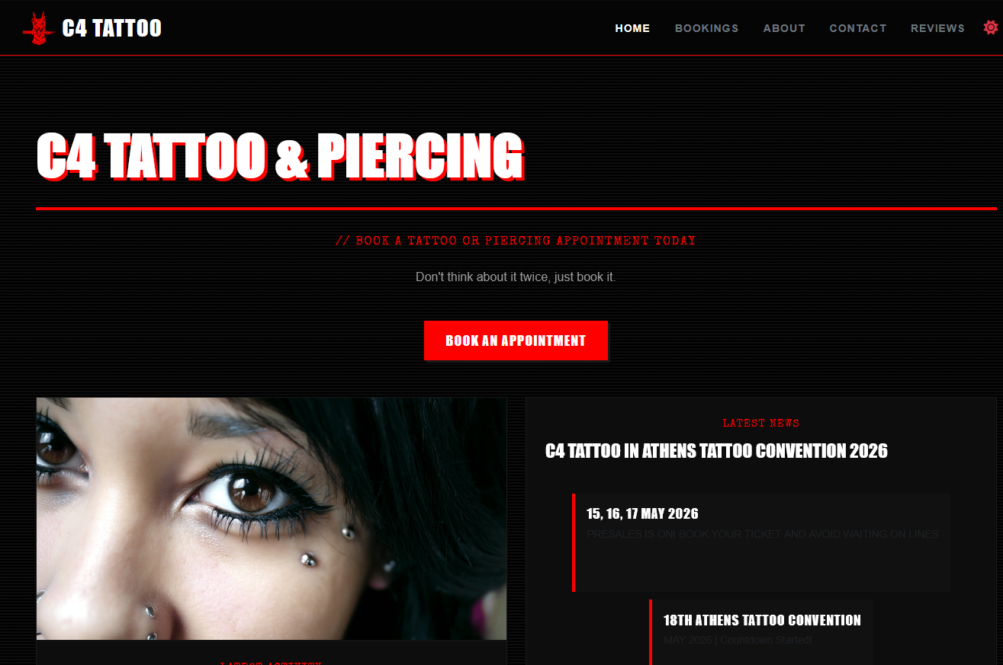

Slide 8
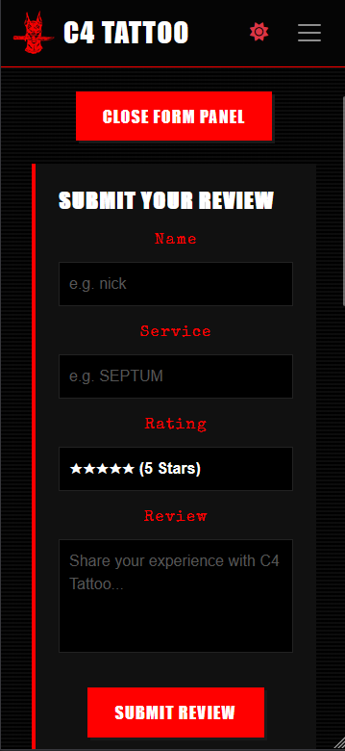
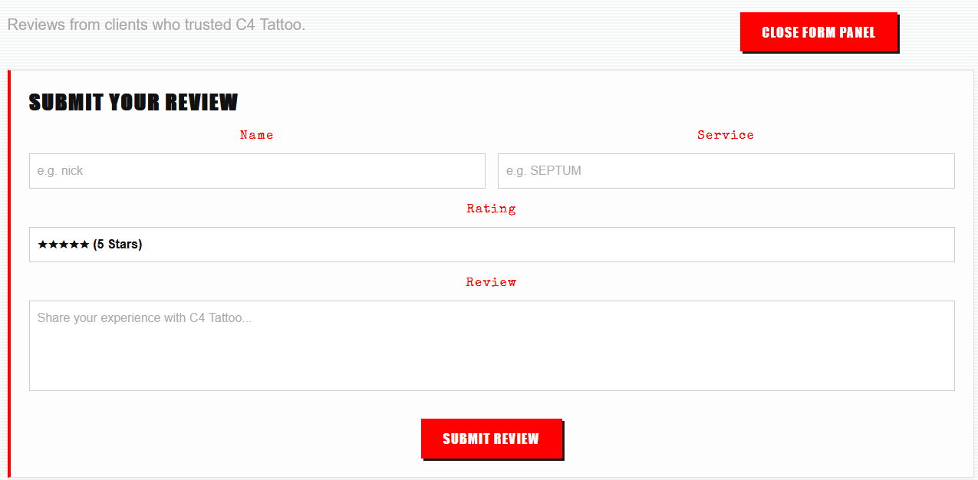

Slide 9
MOBILE vs DESKTOP VIEW BOOKING PROCESS STEPS

Slide 10
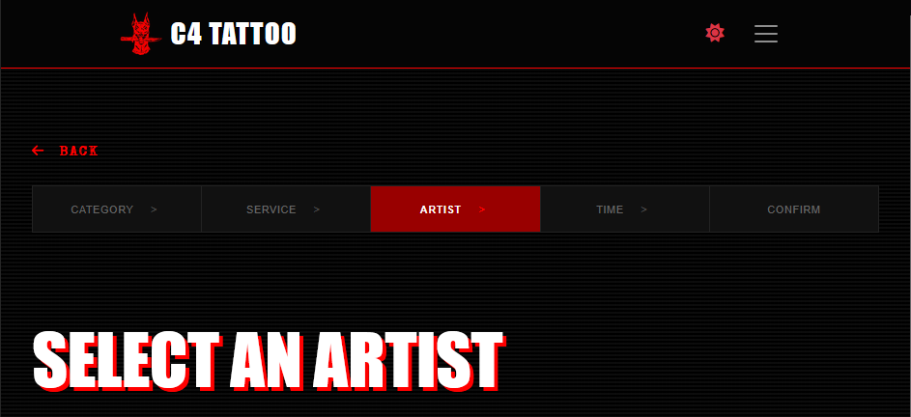

Slide 11
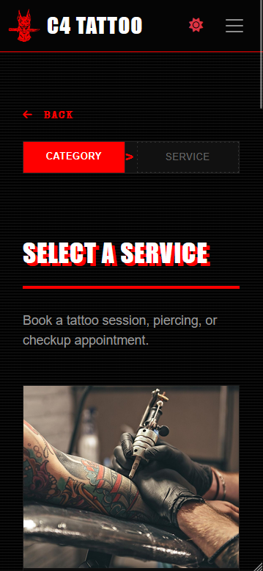
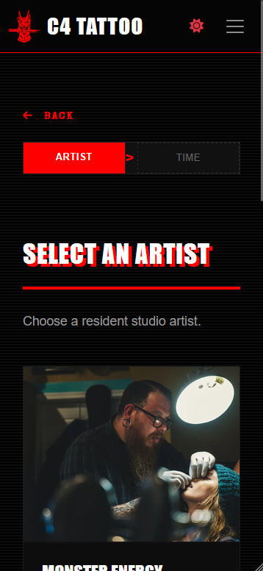
ONLY CURRENT AND NEXT STEP IS SHOWN

Slide 12
BURGER MENU ON DESKTOP & MOBILE

Slide 13
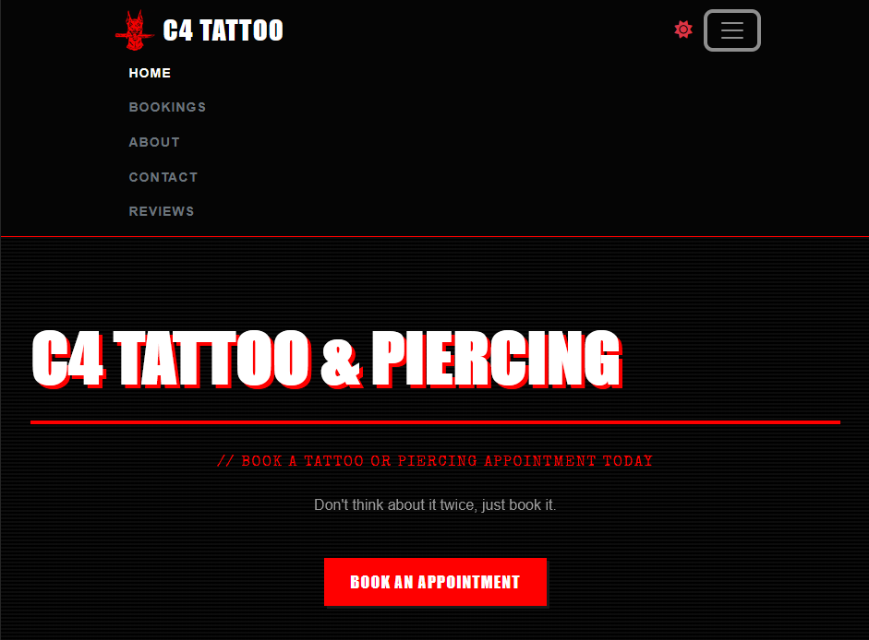

Slide 15
BOOKING SUMMARY TAB

Slide 16
